Slide 1

US FDA Center for Tobacco Products Regulation and Scientific Decision-Making
David L. Ashley, PhD
Research Professor
School of Public Health
Georgia State University
Notes:
Want to encourage people to think outside the box

Slide 2

Disclosures
Since leaving Federal Service, I have received funds for work done
as a research professor at Georgia State University
as an independent contractor for McKing Consulting
for the World Health Organization Tobacco Free Initiative
as a Special Government Employee of the U.S. Food and Drug Administration
and as a consultant for Pfizer
Notes:
I do not work for or speak for FDA

Slide 3
Objectives
Background on FDA-CTP Regulation
The process of regulatory decision-making
The role of scientific studies in tobacco regulatory decision-making
Examples of how science influences tobacco regulatory decisions
Notes:
I do not work for or speak for FDA

Slide 4
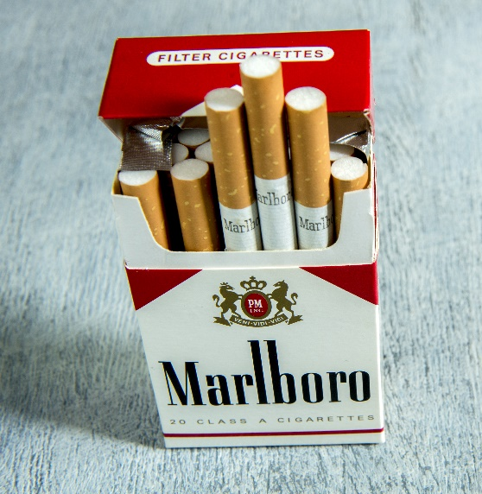
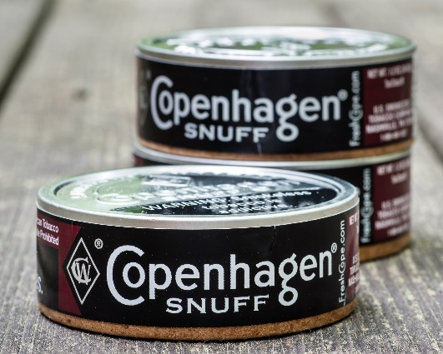

Tobacco Products Regulated by the Tobacco Control Act
Since 2009, CTP has authority to regulate products made or derived from tobacco intended for human consumption
Immediately regulate the manufacture, marketing, and distribution of cigarettes, cigarette tobacco, roll-your-own tobacco, and smokeless tobacco
https://www.gpo.gov/fdsys/pkg/BILLS-111hr1256enr/pdf/BILLS-111hr1256enr.pdf

Slide 5
FDA Authority in the TCA
Knowledge Gathering - Obtain information on the regulated products
Product Review
Restrict product changes to protect public health
Prohibit modified risk claims that state/imply reduced exposure or risk without an order
Product standards
Restrict marketing and distribution to protect public health
Decrease the harms of tobacco products
Compliance and Enforcement - Ensure industry compliance with FDA regulation through education, inspections, and enforcement
Public education - Educate the public about the harms of tobacco use and FDA’s regulatory actions
Research - Expand the science base for regulatory action

Slide 6
The Population Health Standard
Appropriate for the protection of public health, considering:
The risks and benefits to the population as a whole
The increased or decreased likelihood that existing users of tobacco products will stop using such products
The increased or decreased likelihood that those who do not use tobacco products will start using such products
Not the same as safety and efficacy
Notes:
Critical for regulating a legal product that kills half of its users when used as directed.
It is not just the risk of using the product, but also must include the likelihood or starting and the likelihood of stopping

Slide 7
Deeming authority embedded in the TCA
https://www.gpo.gov/fdsys/pkg/BILLS-111hr1256enr/pdf/BILLS-111hr1256enr.pdf
Notes:
In the TCA FDA was given the authority to expand to other types of tobacco products

Slide 8
Deeming Regulation
https://www.gpo.gov/fdsys/pkg/FR-2016-05-10/pdf/2016-10685.pdf

Slide 9

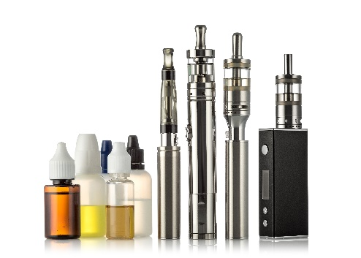


Deeming
On August 8, 2016 regulation went into effect that “deems” all products meeting the statutory definition of tobacco product, including components or parts (but excluding accessories), to be subject to FDA’s tobacco product authorities, including:
ENDS (e-cigarettes, e-cigars, vape pens, etc)
All cigars
Pipe tobacco
Nicotine gels
Waterpipe (hookah)
Dissolvables not already under the FDA’s authority
Future tobacco products
No newly deemed products introduced after February 15, 2007 are on the market legally.
They must undergo scientific review before they are legally marketed
https://www.gpo.gov/fdsys/pkg/FR-2016-05-10/pdf/2016-10685.pdf
Notes:
Deeming was originally a rule to deal with flavored little cigars

Slide 10
Rules/Regulations
Stipulations of the delegated legislation which is drafted by subject-matter experts to enforce a statutory instrument (primary legislation)
Requires notice and comment before finalized
Once it is in force, a regulation is the law
https://en.wikipedia.org/wiki/Regulation

Slide 11
Regulation Development Process
Draft Rule
Final Rule
Implementation
Problem identified
Strategy developed
Draft prepared
Legal authority argument developed
Economic analysis done
Staff level comments
Draft revised
Staff level clearance
First draft completed
Executive orders and other laws done
Paperwork reduction Act section done
Center/Office comments
Draft revised
Center/Office clearance
Paper work reduction Act sign-off
Economic staff sign-off
Legal counsel sign-off
FDA signoff
HHS review, briefing and sign-off
Other agency briefing and sign-off
OMB review
Publication
Comment period
Extend/reopen comment period
Review comments
New draft prepared
Staff level comments
Draft revised
Staff level clearance
Center/Office comments
Draft revised
Center/Office clearance
Paper work reduction Act sign-off
Economic staff sign-off
Legal counsel sign-off
FDA signoff
HHS review, briefing and sign-off
Other agency briefing and sign-off
Publication
Time until the effective date
Deeming, 90 days
Product standards, 1-3 years
Lawsuits

Slide 12
Guidance
Explains FDA’s thinking, when finalized
Does not require notice and comment
Describes how regulated industry could comply with the law
Allows for alternatives
https://www.fda.gov/downloads/TobaccoProducts/Labeling/RulesRegulationsGuidance/
UCM436468.pdf
Notes:
This cannot serve as a basis for FDA decisions

Slide 13

FDA Product Regulatory Actions
As of June 2019, FDA had removed from the market or prevented from being marketed 2697 new tobacco products.
Product Review
One-by-one product decisions
The evidentiary burden is on the applicant
As of October 2019, FDA had issued a final and then reissued a proposed product standard for graphic health warnings on cigarette packaging and advertising and a proposed rule for NNN in smokeless tobacco
Product Standards
Product standards can apply to all products or groups of products
The evidentiary burden is on FDA
Notes:
There are two primary means by which FDA regulates products.
Product review has the advantage that the evidentiary burden is on the manufacturer, but these are one-by-one decisions
Products standards have the advantage that they can be applied to all or a subset of products. But the evidentiary burden is on FDA
Because of the different evidentiary requirements of new product marketing decisions and products standards, FDA is likely to have more impact through marketing decisions.

Slide 14

Premarket review

Slide 15
Product Review
Includes
Investigational tobacco products (ITP)
New product review (PMTA)
Substantial equivalence (SE)
Exemption from SE (SE EX)
Modified risk tobacco products (MRTP)
Applicant must provide adequate evidence for FDA to make a finding – the evidentiary burden is on the applicant
FDA uses scientific research to evaluate the evidence provided by the applicant

Slide 16
Product Review – Statutory Questions
PMTA - Is the marketing of a new product appropriate for the protection of public health?
SE - Do differences between a new product and a predicate product raise different questions of public health?
MRTP - Will the product as it is actually used by consumers significantly reduce the harm and risk of tobacco-related disease to individual tobacco users and benefit the health of the population as a whole?
Notes:
What do each of these phrases mean? How should they be interpreted.
Protection of public health – cause no more harm or reduce harm?
Different questions – New disease never before encountered with tobacco use or potentially increasing harm
As actually used by consumers – How a person is intended to use it or how they use it in the real world including dual use
The population as a whole – Not just current tobacco users, but also includes susceptible users (especially adolescents) and those who may relapse.

Slide 17
Factors that go into a new product authorization decision
the relative risk to smokers of combusted products versus use of the new product
the likelihood that current smokers of combusted products will switch completely to the new product
the likelihood that the product will decrease complete cessation of smoking
the relative risk of poly use
the likelihood of poly use
the relative risk of use of the new product compared to non use of tobacco products
the likelihood that adult non-users will initiate use of the product
the likelihood that adult non-users who initiate use of the product will transition to more harmful combusted products
the risk to health of youth and adolescents initiating the new product including adolescent development
the likelihood that youth and adolescents will initiate use of the new product
the likelihood that youth and adolescents who initiate use of the product will transition to more harmful combusted products

Slide 18
Product Review Considerations
Information
Materials
Ingredients
Design
Composition
Constituents
Other features
Marketing
Impact
Appeal
Addictiveness
Behavior/use
Exposure
Pharmacokinetics
Toxicity
Perception
Initiation
Cessation
Public health
Morbidity
Mortality

Slide 19

Heat not Burn - IQOS

Slide 20
Biomarkers of Exposure with Complete Switching from Smoking to IQOS
SA = Smoking abstention
THS = IQOS
https://www.fda.gov/media/124247/download

Slide 21
IQOS as it is actually used by consumers
90-day US Actual Use trial - At the end of the trial,
7.5% of participants used iQOS at least 95% of the time
7.0% were predominantly using iQOS (70-95%)
22.4% were dual users (30-70% IQOS))
62.7% were predominantly smoking cigarettes
Japanese cross-sectional study – 91.8% of Heated Tobacco Product users reported dual use
4-Week Whole offer test, complete switching
South Korea – 15.7% Japan – 13.6%
Germany – 8.5% Italy – 5.2%
Switzerland – 4.3%
Presentations for PMI to FDA TPSAC (https://www.fda.gov/media/110377/download)
Notes:
This is data from the PMI application
Participants tried an iQOS and indicated that they were interested in trying the product.
Use behavior indicates predominantly dual use. All exposure data was exclusive use.

Slide 22
ENDS/Cigarette Use Behavior and Biomarkers of Exposure
Goniewicz, M. L., Smith, D. M., Edwards, K. C., Blount, B. C., Caldwell, K. L., et al. Comparison of Nicotine and Toxicant Exposure in Users of Electronic Cigarettes and Combustible Cigarettes. JAMA Netw Open. 2018 Dec 7;1(8):e185937. doi: 10.1001/jamanetworkopen.2018.5937.
Notes:
These are participants in the PATH study
Dual users do not reduce their exposure to harmful constituents, but exclusive ENDS users do.

Slide 23
Product Review – FDA Response
The observational studies reported by the applicant suggest that dual use with combusted cigarettes is the predominant pattern of IQOS use, whereas exclusive use was relatively less prevalent
The evidence is not sufficient to demonstrate that dual use of combusted cigarettes and the IQOS system, the most commonly reported pattern of use in the observational studies described below, is associated with a meaningful reduction in exposure or disease risk.
As described above, dual use of cigarettes and the IQOS system is not likely to provide a benefit over exclusive smoking.
Finally, there is a potential concern related to consumer understanding of the difference between exclusive IQOS use and dual use of IQOS with other tobacco products.
https://www.fda.gov/media/139796/download

Slide 24
Product Review – FDA Response
Studies required: These studies should be designed to observe behavior over a sufficient period of time to examine, for instance, the extent to which dual use
of IQOS and combusted cigarettes is a transitional versus stable pattern of use.
Real world use behavior – exclusive or dual use
Appeal to adolescents
Health risk for exclusive and dual use
https://www.fda.gov/media/139796/download

Slide 25

PRODUCT STANDARDS

Slide 26
Product Standards
Through rulemaking, the Tobacco Control Act allows adoption of “…tobacco product standards… appropriate for the protection of public health.” Sec 907.
Nicotine yields
Reduction or elimination of constituents, including smoke constituents
Construction, components, ingredients, additives, constituents, and properties of the tobacco product
Provisions for testing or measuring product characteristics
Restrictions on sale and distribution
Form and content of labeling for the proper use of the tobacco product
The evidentiary burden for product standards rests on FDA
https://www.gpo.gov/fdsys/pkg/BILLS-111hr1256enr/pdf/BILLS-111hr1256enr.pdf

Slide 27
Product Standards
Product standards cannot do the following:
https://www.gpo.gov/fdsys/pkg/BILLS-111hr1256enr/pdf/BILLS-111hr1256enr.pdf

Slide 28
Product Standards – Decision Points
Once the standard is in place, FDA must be able to answer the question - Does a specific marketed product meet the standard?
To answer these questions, the standard should be
Justifiable – is there adequate evidence?
Necessary – is this the least costly alternative to achieve the goal?
Appropriate – will it do what it claims to do?
Unambiguous – is the requirement clear?
Measurable – are there methods to measure?
Quantifiable – can the methods distinguish products that meet the standard from products that do not?
Notes:
This is a 2-3 year process not counting lawsuits

Slide 29
Product Standards – Tobacco-specific nitrosamines
O
C
H
3
N
N
N
O
N
O
N
N
N-nitrosonornicotine (NNN)
4-(Methylnitrosamino)-1-
(3-pyridyl)-1-butanone (NNK)
N
N
N
O
N
O
N
N
N-nitrosoanatabine (NAT)
N-nitrosoanabasine (NAB)

Slide 30
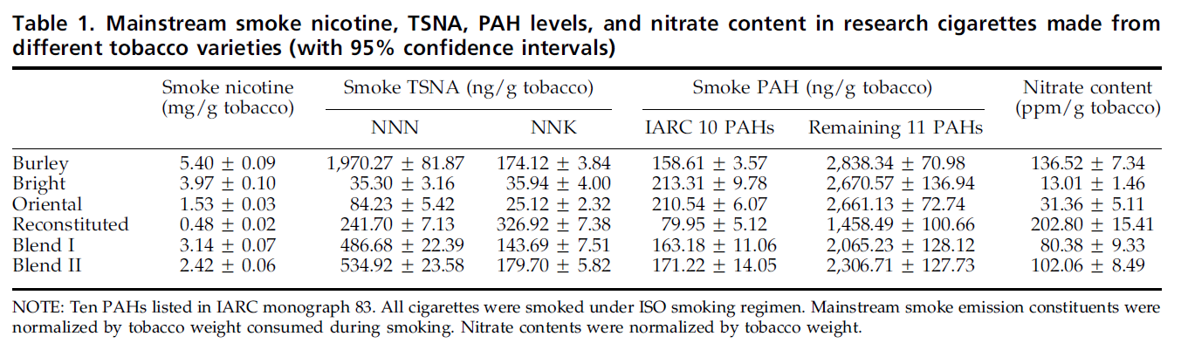
TSNAs in tobacco smoke vary widely due to differences in the tobacco used
Ding et al. Levels of tobacco-specific nitrosamines and polycyclic aromatic hydrocarbons in mainstream smoke from different tobacco varieties. Cancer Epidemiol Biomarkers and Prev 2008;17(12):3366-71.

Slide 31
TSNAs in smokeless tobacco
In addition to tobacco type, other factors that also impact levels of TSNAS in tobacco include:
Growing conditions: Increased rainfall is associated with higher tobacco TSNAs
Curing process: Tobacco TSNAs are lower with reduced humidity and better air flow during curing
Production process: Use of non-nitrate producing bacteria in fermentation reduces TSNAs
Pasteurization or heat-treatment: Lower microbial activity leads to lower TSNAs
Storage: Higher storage temperatures leads to increased TSNAs

Slide 32
NNN in smokeless tobacco in the US
Lawler, T. S., Stanfill, S. B., Zhang, L., Ashley, D. L. and Watson, C. H. Chemical characterization of domestic oral tobacco products: total nicotine, pH, unprotonated nicotine and tobacco-specific N-nitrosamines. Food Chem Toxicol. 2013 Jul;57:380-6.

Slide 33
TSNAs in smokeless tobacco
Lawler, T. S., Stanfill, S. B., Tran, H. T., Lee, G. E., Chen, P. X., Kimbrell, J. B., Lisko, J. G., Fernandez, C., Caudill, S. P., deCastro, B. R. and Watson, C. H. Chemical analysis of snus products from the United States and northern Europe. PLoS One. 2020 Jan 15;15(1):e0227837.

Slide 34
Esophageal Cancer Risk and SLT Use
Modified from Lee, P.N. and Hamling, J.S. Systematic review of the relation between smokeless tobacco and cancer in Europe and North America. BMC Medicine 2009;7(1):36-36

Slide 35
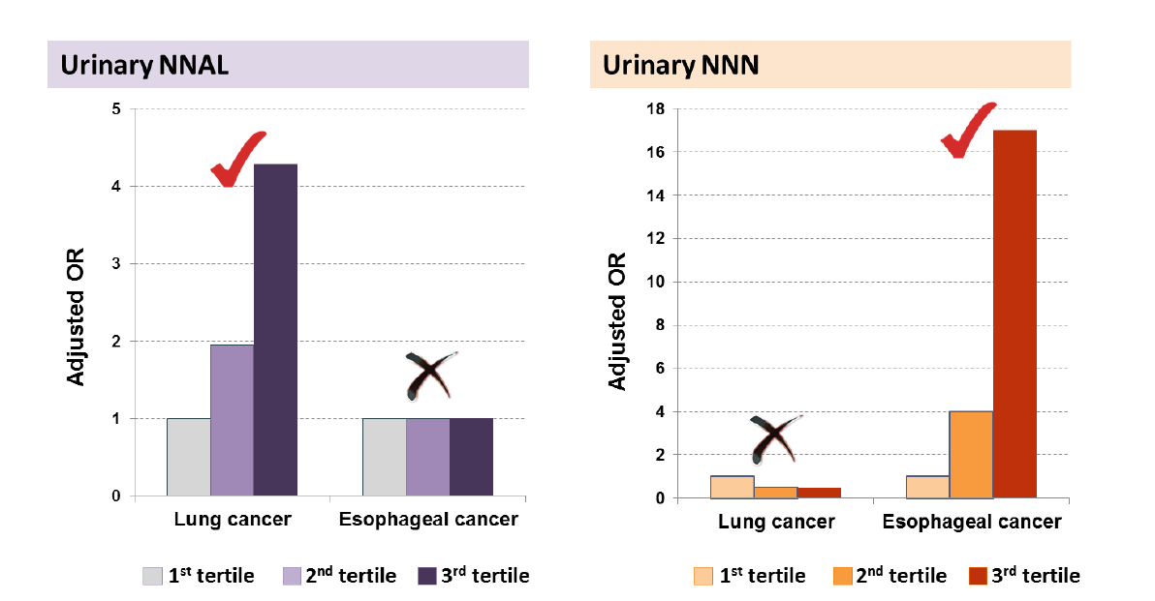
NNK exposure has been linked to lung cancer and NNN exposure has been linked to oral cancer
Slide from I. Stepanov and D. Hatsukami, SRNT 2017 Annual Meeting, Florence, Italy. Data from J.-M. Yuan et al, Carcinogenesis 32(9): 1366-1371 (2011); I. Stepanov et al., Int J Cancer 134:2278-2283 (2014)

Slide 36
NNN in Smokeless Tobacco Proposed Rule
https://www.govinfo.gov/content/pkg/FR-2017-01-23/pdf/2017-01030.pdf

Slide 37
Questions?
David L. Ashley, Ph.D.
RADM (retired) US Public Health Service
Research Professor
404-413-1540
dashley4@gsu.edu
http://publichealth.gsu.edu

